Slide 1




Project
Mental Wellness Companion
Presented by:
Shreya Garg 21csu457
Ritika Gupta 21csu362

Slide 2
Outline
The Problem
Design a mobile application in Flutter to promote mental wellness. Offer features like guided meditations, breathing exercises, mood tracking, and journaling prompts.
Integrate with mental health resources (if APIs are available) or provide curated content.
Include features for setting goals, reminders, and celebrating progress.
Utilize state management (Provider or Bloc) to personalize user experience based on mood and progress.

Slide 3

The Project Description
The Mental Wellness Companion app aims to support users in managing their mental well-being through a comprehensive set of tools. These include guided meditations, breathing exercises, mood tracking, and journaling prompts. By leveraging state management techniques and integrating with available mental health resources, the app offers personalized experiences to promote mental wellness. The app also features goal-setting and reminder functionalities to help users maintain their mental health routines

Slide 4
Requirements
1.1 Hardware Requirements
Smartphone or tablet running iOS or Android
Internet connectivity for accessing curated content and mental health resources
1.2 Software Requirements
Flutter SDK
Dart programming language
Visual Studio Code
APIs for mental health resources

Slide 5
FEATURE OVERVIEW
Guided meditations
Breathing exercises
Mood tracking
Journaling
Goal setting and reminders

Slide 6
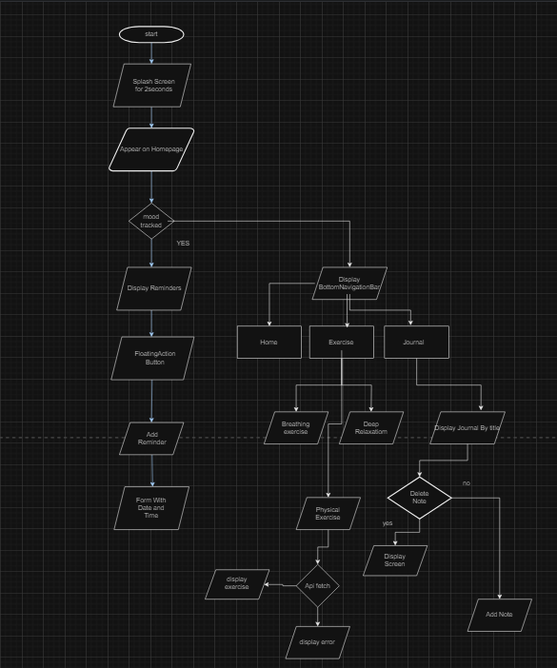
WORKFLOW

Slide 7
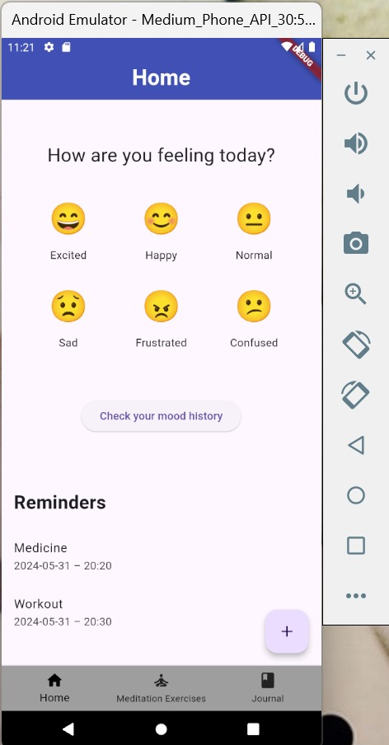
Implementation
Home Screen
1
Home screen with mood tracking and reminders

Slide 8
Implementation
Navigation
1
Bottom Navigation Bar for screen switching (bottom_navigation.dart).

Slide 9
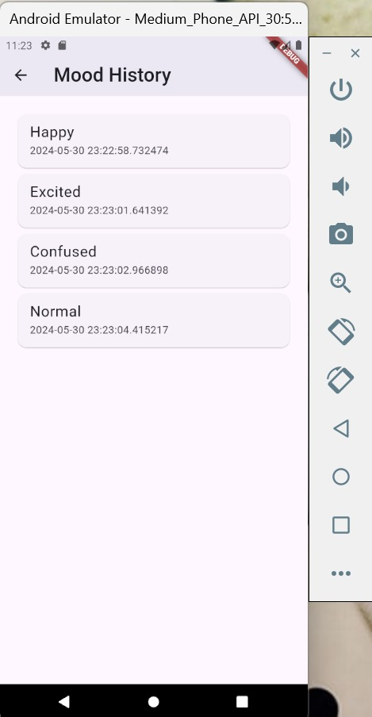
Implementation
Mood Tracking
1
Input mood and display history (mood_tracking_screen.dart).

Slide 10
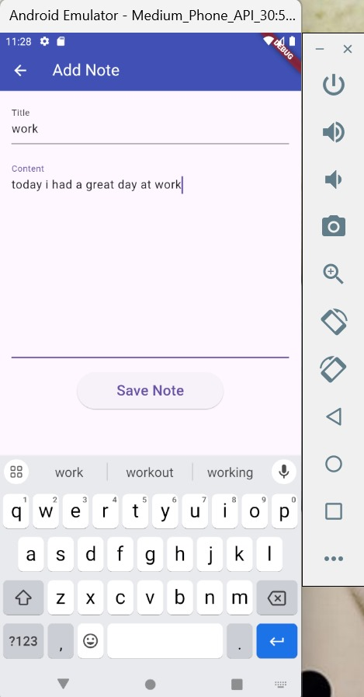
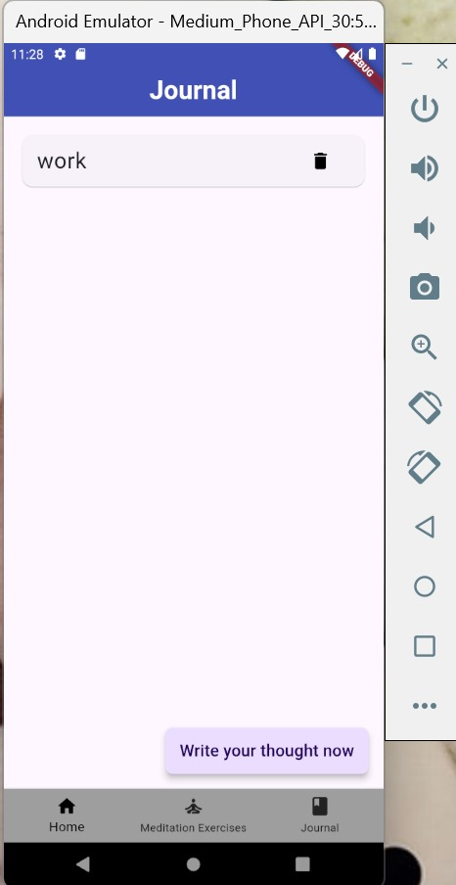
Implementation
Journaling
1
Journal screen with a floating action button for new entries (journal_screen.dart).
Also Display of previous journals and delete functionality

Slide 11
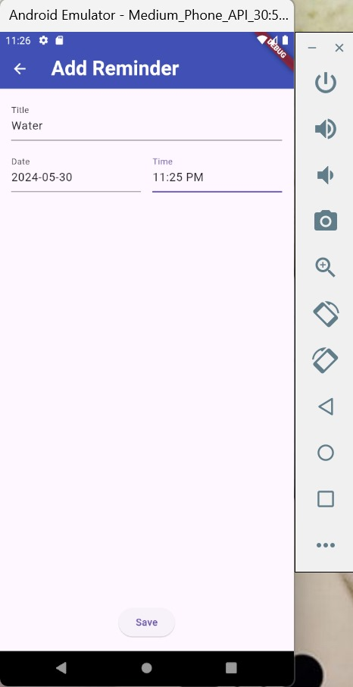
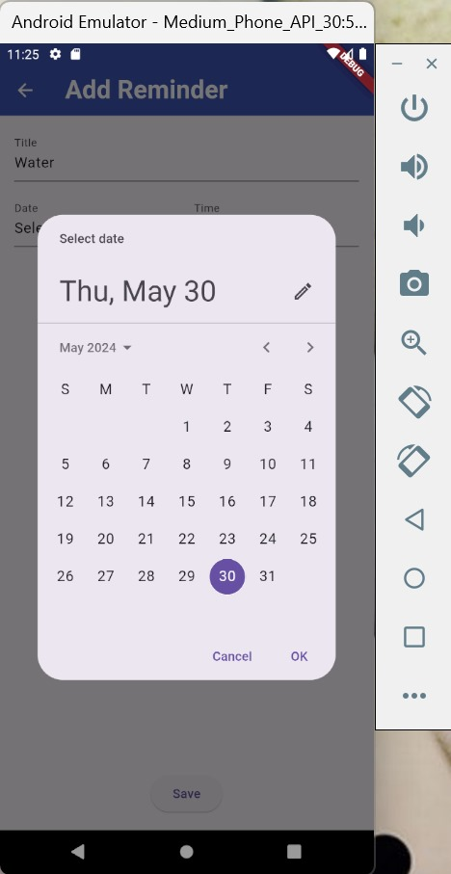
Implementation
Reminders
1
Viewing and adding reminders with date and time (reminder_screen.dart, add_reminder_screen.dart).

Slide 12
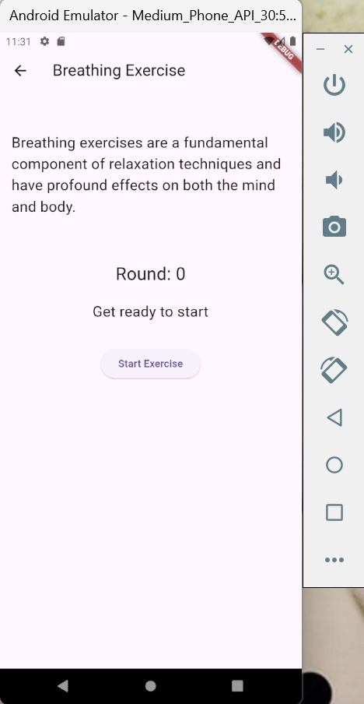
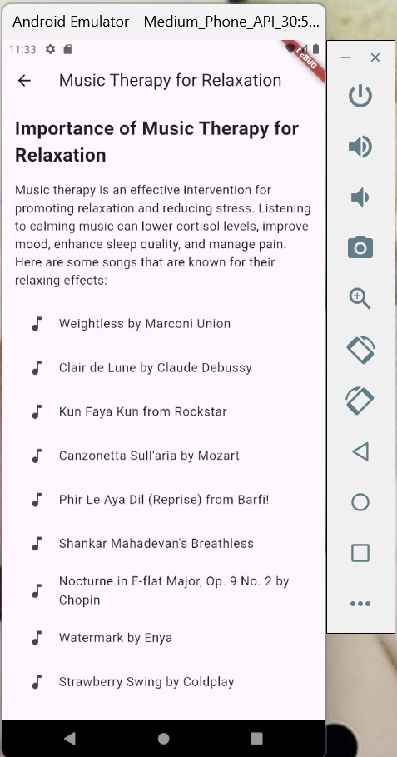
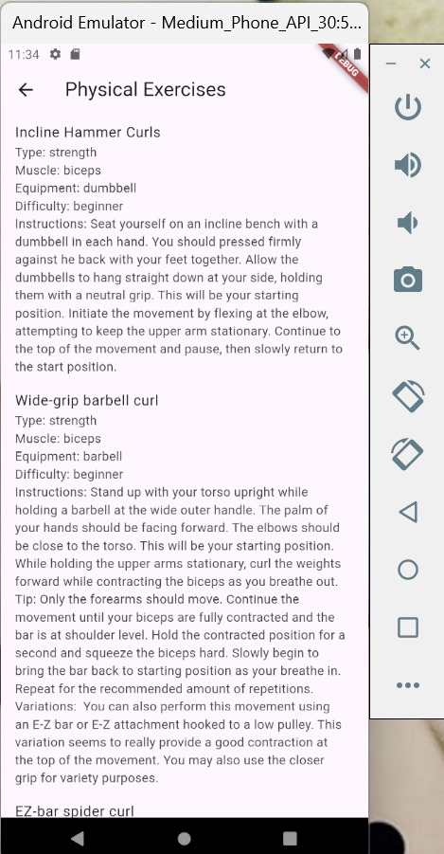
Implementation
Exercise
1
Guided breathing exercise with animated cycle along with physical exercises

Slide 13
Future Scope
Integration: More mental health resources and APIs.
Analytics: Enhanced user data analytics for personalized recommendations.
Community: Features for user interaction and support.
Localization: Support for multiple languages to reach a broader audience.

Slide 14
THANK YOU
PROJECT LINK: https://github.com/ritika362/Mental-Wellness-Companion-App.git

